Slide 1
Specialty Division
Philippine Educational Measurement and Evaluation Association
Presented By: Toni Rose Piñero, RPm
Notes:
Good afternoon everybody. My name is Toni Rose Pinero and I am heading the specialty division on Online and Computerized Assessment

Slide 2
20 years ago…
Website copywriter
Social media manager
Virtual assistant (VA)
Internet marketer
Online business manager
Content strategist
Blogger
App developer
Community Manager
SEO specialist
App Developer
Market Research Data Miner
Educational or Admissions Consultants
Millennial Generational Expert
Chief Listening Officer
Cloud Computing Services
Elder Care
Sustainability Expert
User Experience Design
These were jobs that did not exist yet.
SOURCES:
http://nextnetwork.ca/careers-that-exist-now-didnt-20-years-ago/ http://www.forbes.com/sites/meghancasserly/2012/05/11/10-jobs-that-didnt-exist-10-years-ago/
Notes:
20 years ago… these designations… were jobs that did not exist yet…
In the 21st century, technology has placed a huge role in various industries.
This also includes a huge impact in the industry of education.

Slide 3
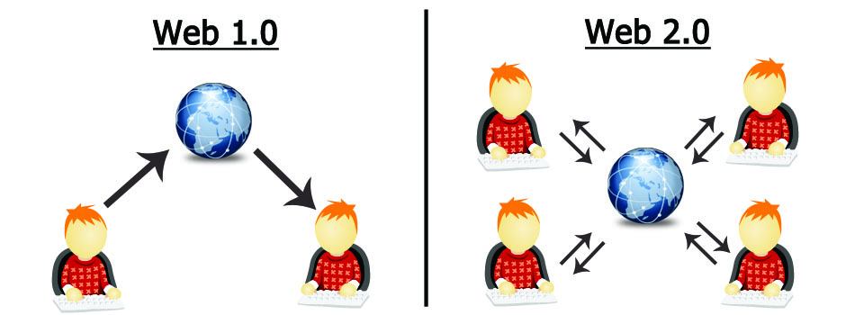
Developments in Educational Technology
Users are just consumers of content
Users both act as consumer and creators of content
Notes:
A brief picture of the development of educational technology is what we refer to Web 1.0 and Web 2.0
In Web 1.0 users are just consumers of content
In Web 2.0 users both act as consumer and creators of content
Examples of Web 2.0 include social networking sites, blogs, wikis, folksonomies, video sharing sites, hosted services, Web applications, and mashups

Slide 4
Learning Management System
According to Wikipedia – a Web 2.0 tool– “a learning management system (LMS) is a software application for the administration, documentation, tracking, reporting and delivery of electronic educational technology (also called e-learning) education courses or training programs.”
Source: https://en.m.wikipedia.org/wiki/Learning_management_system
Notes:
One example of a huge impact of technology in education is the rise of what we call Learning Management System.
According to Wikipedia – a Web 2.0 tool– “a learning management system (LMS) is a software application for the administration, documentation, tracking, reporting and delivery of electronic educational technology (also called e-learning) education courses or training programs.”

Slide 5
Learning Management System
Notes:
Such examples of Learning Management Systems are Edmodo, Desire2Learn, Moodle , Google Classroom and Blackboard,
I’m sure some of you are already familiar with these applications or already using these tools in their teaching practice. These are like “Virtual Classrooms” and is only ONE of the many ways that technology has influenced our teaching practices.
The changes happening in educational technology does not only mean a transfer from pen and paper and uploading the content it online or saving it on a flash drive. Educational technology does not only mean asking students to use a technology for the sake of joining the band wagon. I will show a comic that shows an example of a teacher applying a Web 2.0 tool inside the classroom.

Slide 6
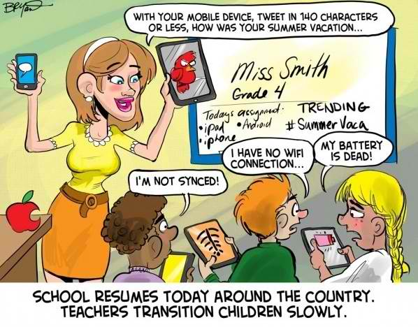
Notes:
In this scenario the Teacher uses the Web 2.0 tool, Twitter to assess how the students evaluate their summer vacation.
Teacher says, with your mobile device, tweet in 140 characters or less, how was your summer vacation.
Students says, “I’m not synced” “I have no wifi connection” “My battery is dead”.
The statement below reads “School resumes today around the country. Teachers transition children slowly”.

Slide 7
Notes:
Let’s remove the word children and not the statement reads “School resumes today around the country. Teachers transition slowly”. I’m referring to how we as teachers transition slowly in adapting technology in education, the “proper” way.
“Teachers transition slowly”. This statement is actually both a challenge and reality in our industry.

Slide 8
There is so much more that teachers need to learn in understanding the teaching and learning process of using technology inside or outside the classroom.
Notes:
There is so much more that teachers need to learn in understanding the teaching and learning process of using technology inside or outside the classroom.
This is why the division of Online and Computerized assessment has been established by PEMEA.

Slide 9
The first objective of this division is to develop a set of standards on online and computerized assessment.
Notes:
The first objective of this division is to develop a set of standards on online and computerized assessment.
What is the “proper” way to adapt online or computerized assessments?

Slide 10
Notes:
To give you a clearer picture of this objective: Inacol, international association for online learning, for example, developed a national standards for Quality Online Teaching.

Slide 11
Standards on quality online and computerized assessment.
Notes:
Being that PEMEA focuses on assessment, this division will focus on developing standards on QUALITY online and computerized assessment. I would like to point out that this does not necessarily mean entirely relying on the internet but the division will tackle assessment that utilizes any form of technology both offline and online.

Slide 12
What are the necessary requirements that we need to consider when we deliver online and computerized assessment?
i.e. delivery, type of technology, interface, design & many more factors.
Notes:
What are the necessary requirements that we need to consider when we deliver online and computerized assessment? This may include deciding on mode of delivery, type of technology, interface, design and many more factors.

Slide 13
Invitation to join the Specialty Division of:
e-mail me at toni_pinero@dlsu.edu.ph
Notes:
If you are one of those people who have the passion or interest for educational technology, I would therefore like to invite you to join the specialty division of online and computerized assessment.

Slide 14
Invitation to join the Specialty Division of:
What should be the standards for a quality online or quality computerized assessment?
Notes:
Join me and my team in answering "What should be the standards for a quality online or quality computerized assessment?"

Slide 15
Specialty Division Partners
Google Education
Pearson Assessments
Intel Education
Microsoft Course Academy
EdTech Asia
Blended Learning Services
EdTech World Tour
University of the Philippines Open University (UPOU)
Notes:
WHERE IS THE DIVISION NOW? The division was founded just a month ago. And for the whole month of September I have been communicating and personally meeting professionals from institutions that are already implementing the practice of online or computerized assessment. These are experts coming from the Philippines and abroad whether Europe, America and Asia. That’s what’s great with technology, if you know how use it properly then it opens you to unlimited possibilities. This is actually how we got Google and Edtech asia to be partners in our International Conference next school year, as shown in the program booklet that you have in your kits.
Going back to the countless of meetings and e-mails that I had this past month, most of the companies that they are affiliated with are leading in the application of technology in education. Such as, Google Education, Pearson Assessments, Intel Education, Microsoft Course Academy, EdTech Asia, Blended Learning Services, EdTech World Tour, University of the Philippines Open University (UPOU).
I have sought assistance from representatives of these institutions to help and support me in the feat of developing standards on online and computerized assessment. But the puzzle I'm trying to build is not yet complete because I need to build a local team of passionate teachers who will help me develop these standards.

Slide 16
Invitation to join the Specialty Division of:
If you are interested to join me in this endeavor, please feel free to e-mail me at toni_pinero@dlsu.edu.ph
Notes:
If you are one of those people who have the passion for educational technology, I would therefore like to invite you to join the specialty division of online and computerized assessment. Please feel free to e-mail me at the e-mail posted in the screen.
Thank you very much and I am looking forward to new members of this division. Have a nice day.

