Slide 1
Global Trends in Measurement and Evaluation
Maria Felicitas (Marife) M. Mamauag, PhD
Assessment Consultant-Senior Lecturer
HELP University, Malaysia
International Conference in Educational Measurement and Evaluation (ICEME2018)
August 23-25, 2018 Manila, Philippines

Slide 2
ICEME2018
Manila, Philippines

Slide 3
ITC’s Guidelines…
The ITC Guidelines on Test Use (2001)
The ITC Guidelines for Translating and Adapting Tests (2005)
The ITC Guidelines on Computer-Based Testing and
Internet-Delivered Testing (2006)
The ITC Guidelines on the Security of Tests, Examinations
and other Assessments (2014a)
The ITC Guidelines on Quality Control in Scoring, Test
Analysis, and the Reporting of Test Scores (2014b)
The ITC Guidelines in Practitioner Use of Test Revisions,
Obsolete Tests and Test Disposal (2015)
ICEME2018
Manila, Philippines

Slide 4
ICEME2018
Manila, Philippines

Slide 5
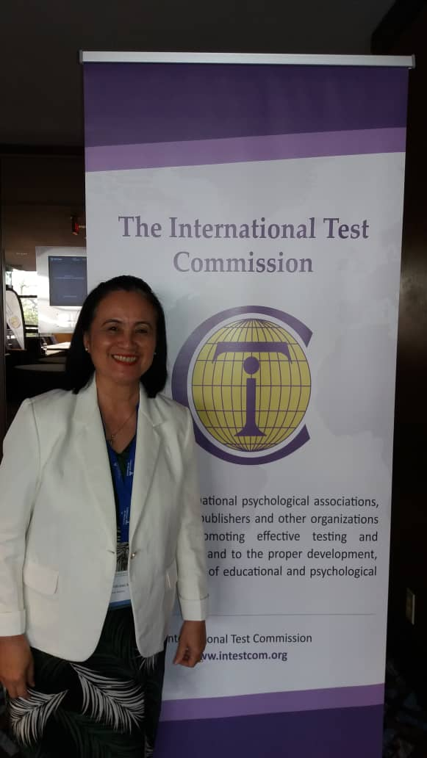
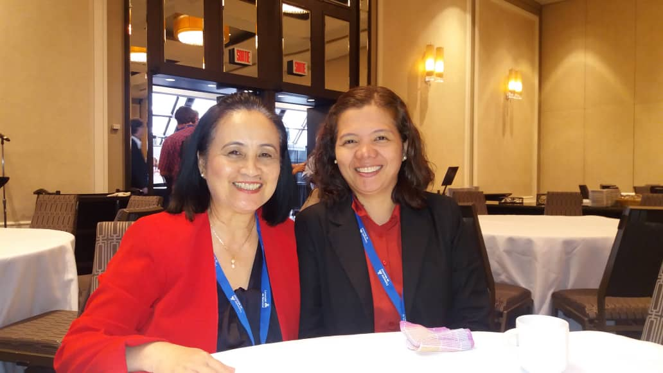
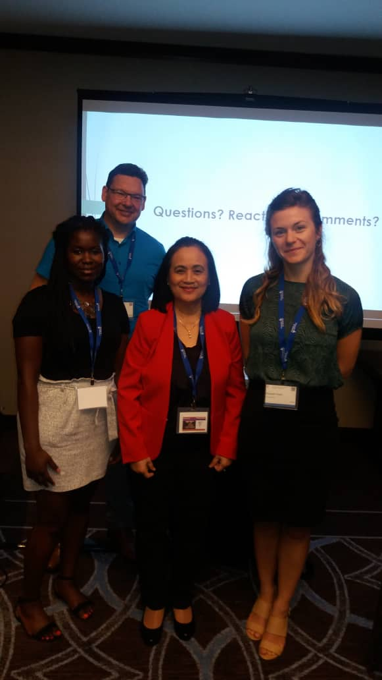
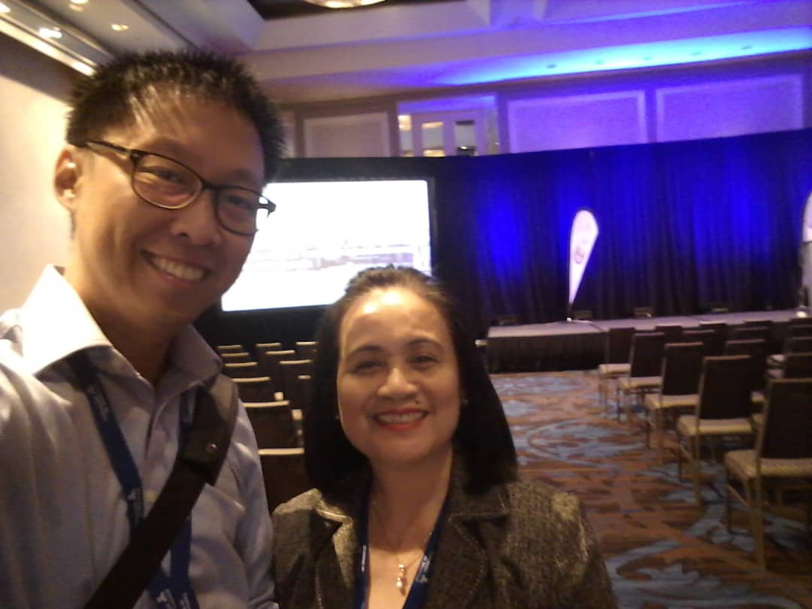
ICEME2018
Manila, Philippines

Slide 6
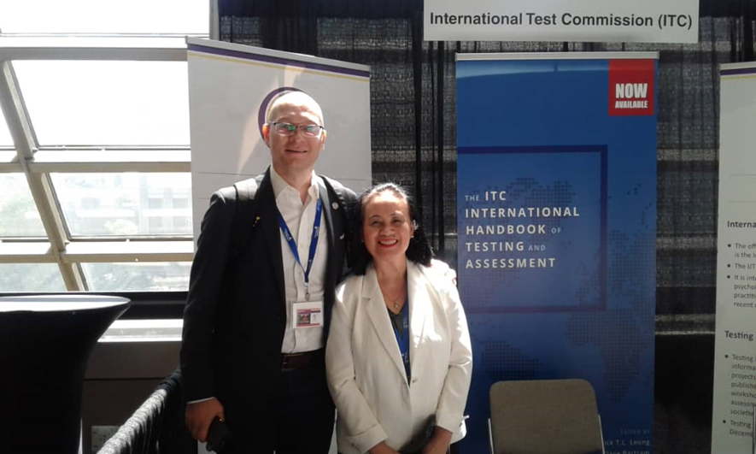
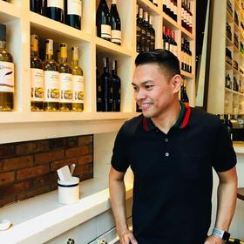
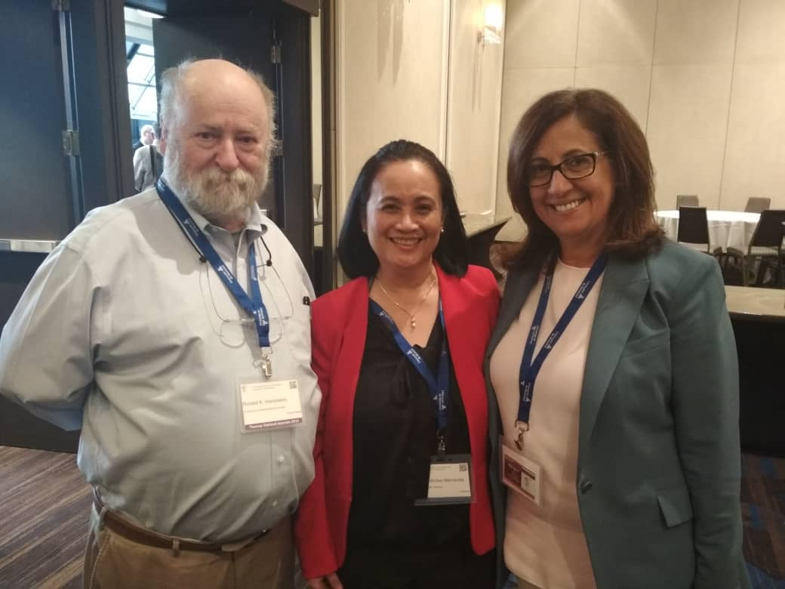
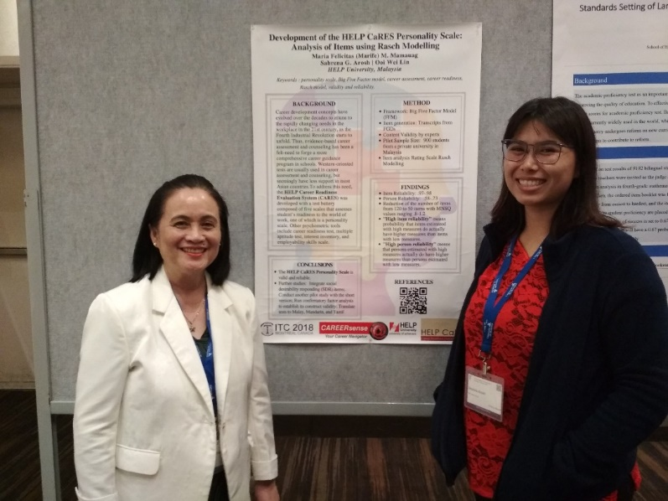
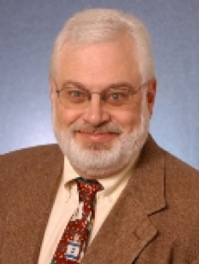
ICEME2018
Manila, Philippines

Slide 7
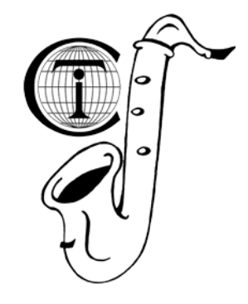
ITC2018’s Theme: On the beat of testing!
ICEME2018
Manila, Philippines

Slide 8
ITC2018’s Sub-Themes
Best Practices in Testing and Assessment
Instruments and their Validity
Effectiveness and Efficiency including Application in Multicultural Environments
Challenges, Innovation and Advances in Technology
ICEME2018
Manila, Philippines

Slide 9
Content Analysis of ITC2018’s Abstracts
Keynote Papers - 11
Symposia – 29
Panel Discussions – 7
Workshops – 7
Oral/Poster Presentations – 241
Total: 295 abstracts
ICEME2018
Manila, Philippines

Slide 10
ICEME2018
Manila, Philippines

Slide 11
ICEME2018
Manila, Philippines

Slide 12
ICEME2018
Manila, Philippines

Slide 13
ICEME2018
Manila, Philippines

Slide 14
ICEME2018
Manila, Philippines

Slide 15
Challenges, Innovation and Advances in Technology
Top 3 Emerging Strands:
Response Bias
Test Adaptation
Technology Use
ICEME2018
Manila, Philippines

Slide 16
1. Social Desirable Response Bias
Social desirable responding (SDR) in self-report measurement has been a great challenge among test developers over the decades
Notes:
Socially desirable responding (SDR) in self-reports is a key concern in psychometric tools that are non-cognitive in nature. A critical assumption of self-reports is that respondents accurately bring to mind-relevant information and attempt to provide honest responses (McINtie & Miller, 2000). To the extent that individuals instead provide socially desirable responses (over-reporting positive behavior or under-reporting negative behaviours), the validity of the scores could be compromised. Accordingly, social desirability scales are widely used to assess the extent to which individuals bias responses in a self-favoring manner and control for such distortions (Pailhaus, 2002).
Typically, such response biases are identified by administering an SDR scale alongside with scales of interest.

Slide 17
Balanced Inventory of Desirable Responding
Balanced Inventory of Desirable Responding (BIDR-16)
Developed by C.M. Hart, et al. (2015)
Two factor-structure of BIDR-16
BIDR-16
Impression Management
(bias towards pleasing others)
Self-Deceptive Enhancement
(honest but overly positive responding)

Slide 18
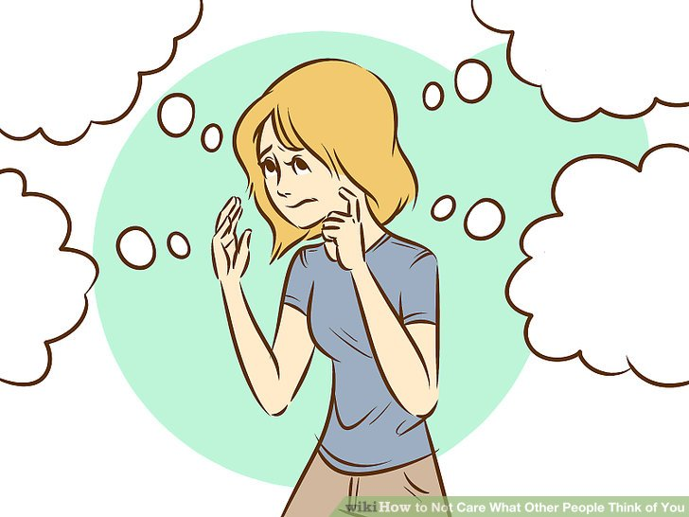
Impression Management
Notes:
Impression Management
Bias towards pleasing others
The need for approval
Thinking too much about what other people think
Just like going for an interview…you want to please them so they will approve

Slide 19
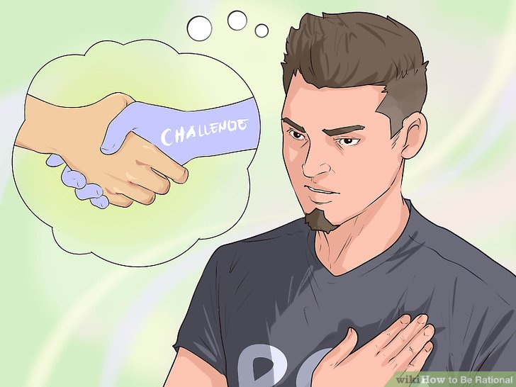
Self-deceptive Enhancement
Notes:
Self-deceptive Enhancement
Honest but overly positive
Confident about it’s own judgement
Believe in handling the challenges
Just like the cat believing and see itself as a lion
Believing that you can achieve what you want

Slide 20
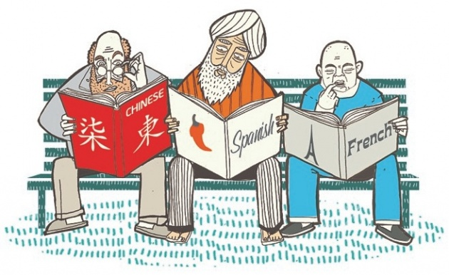
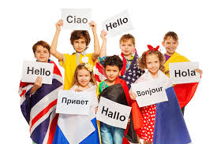
2. Test Adaptation and Translation
ICEME2018
Manila, Philippines

Slide 21
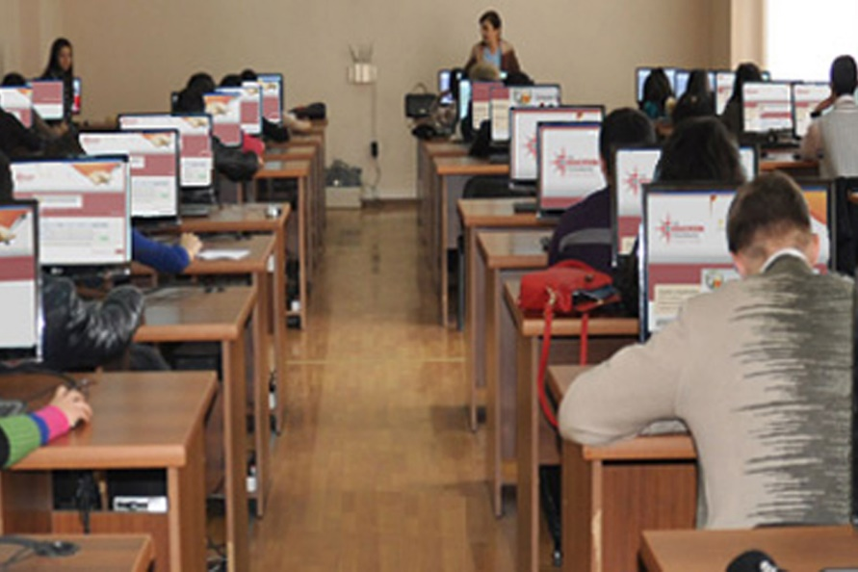
3. Technology Use: CBT versus PBT?
ICEME2018
Manila, Philippines

Slide 22
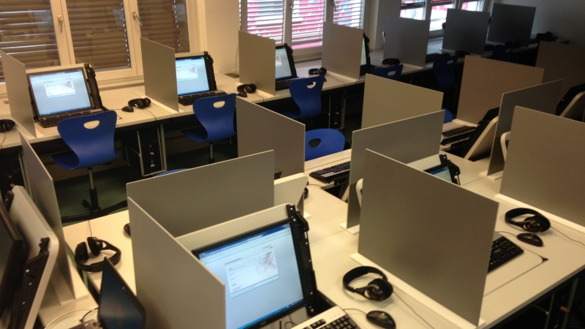
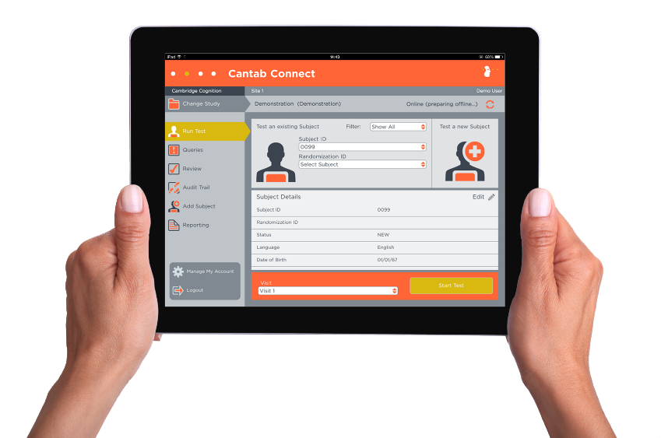
AIG: Automatic Item Generation
ICEME2018
Manila, Philippines

Slide 23
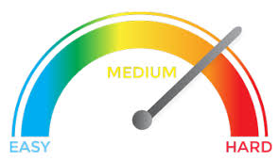
CAT
ICEME2018
Manila, Philippines

Slide 24
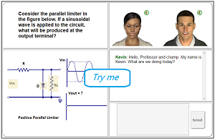
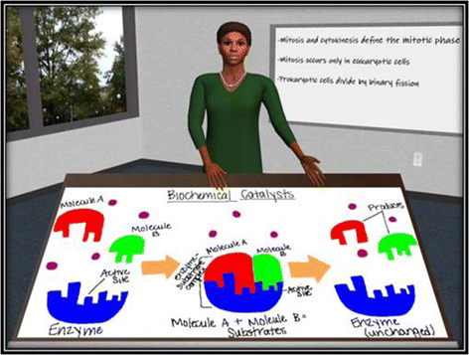
Human Tutorial Dialogue
ICEME2018
Manila, Philippines

Slide 25
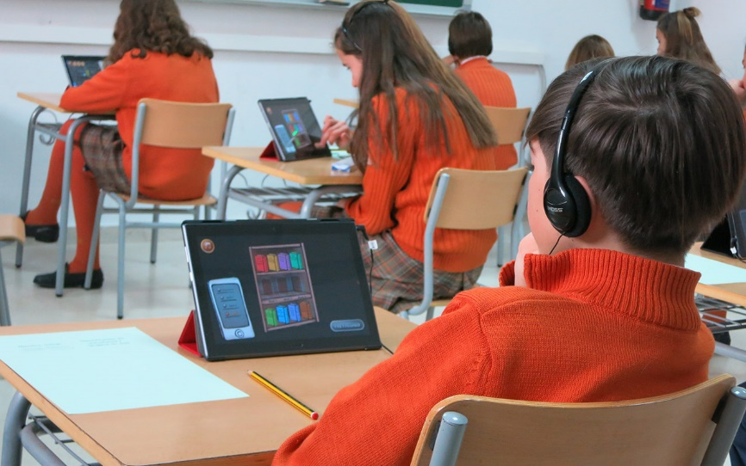
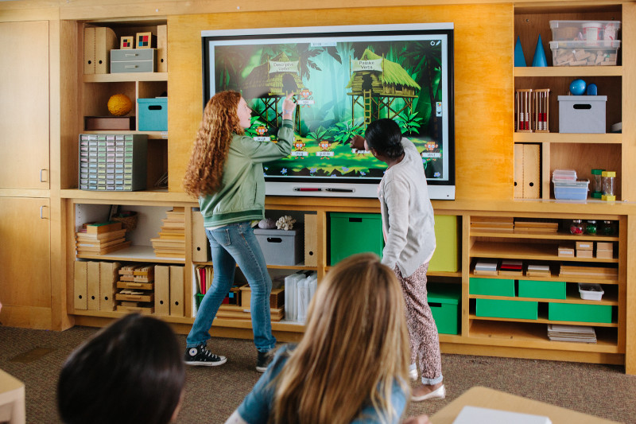
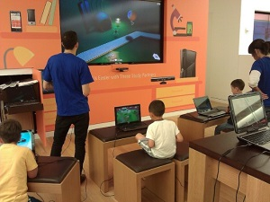
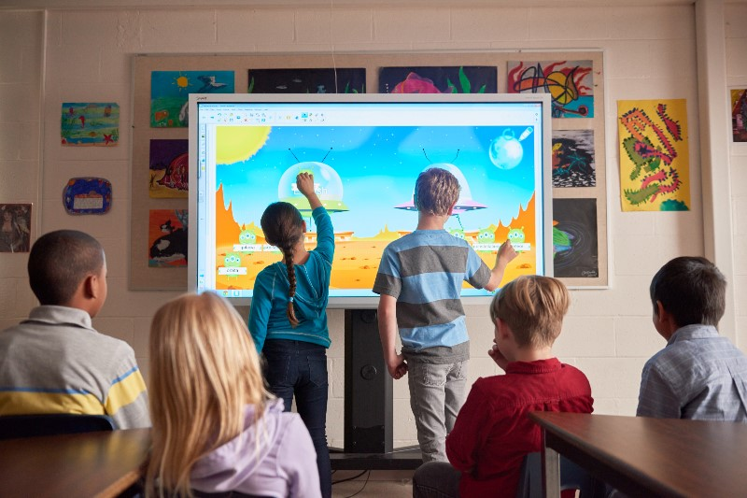
GBA: Games-Based Assessments
ICEME2018
Manila, Philippines

Slide 26
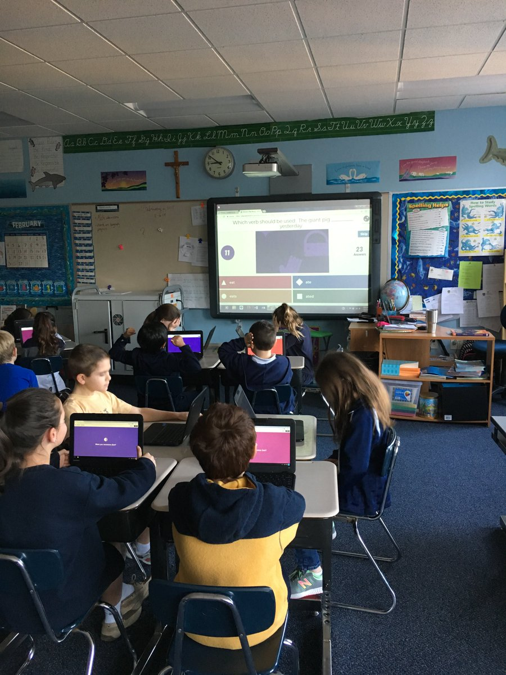
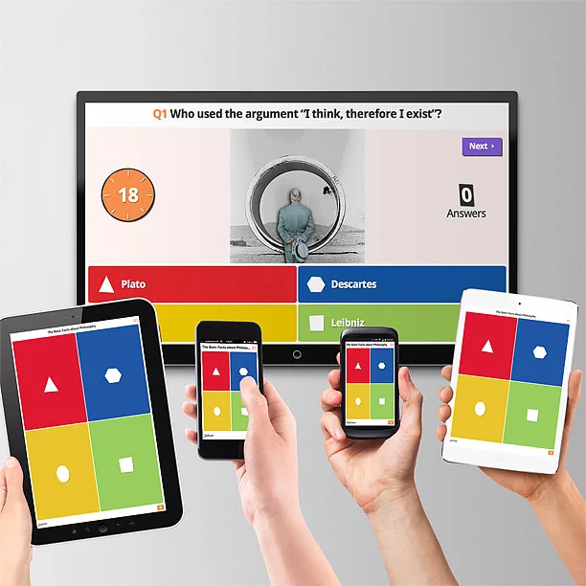
Gamified Quizzes
ICEME2018
Manila, Philippines

Slide 27
ITC2018’s Theme: On the beat of testing!
ICEME2018
Manila, Philippines

Slide 28
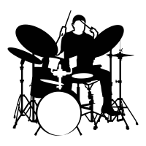
Are we drumming
the right beat of testing?
Are we upbeat?
If NOT…then what’s up?
ICEME2018
Manila, Philippines

Slide 29
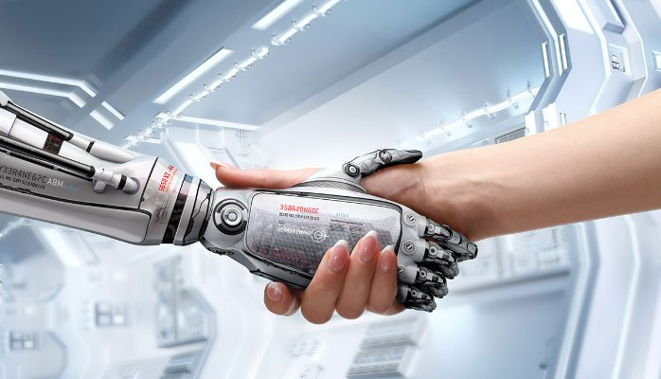
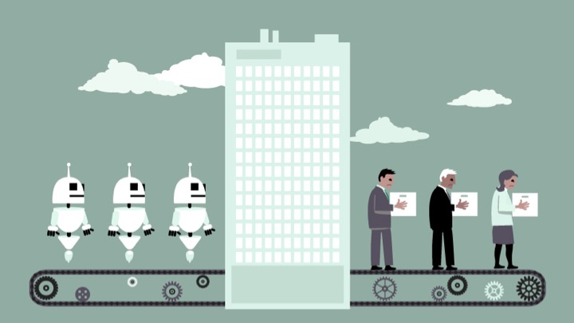
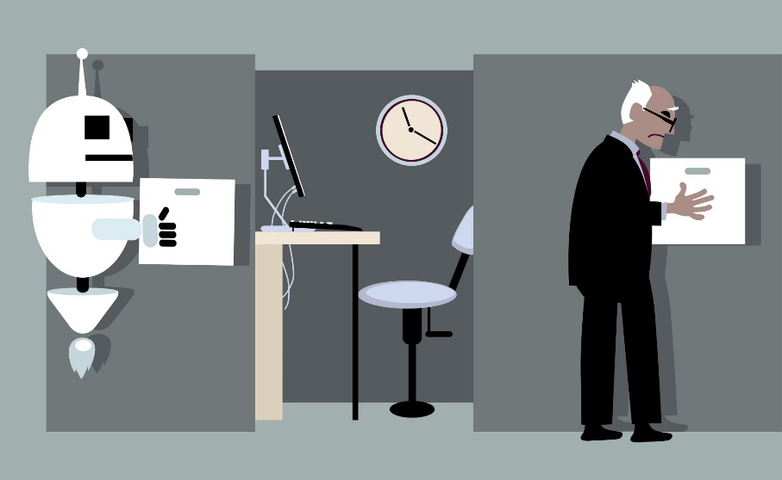
Fourth Industrial Revolution…

Slide 30
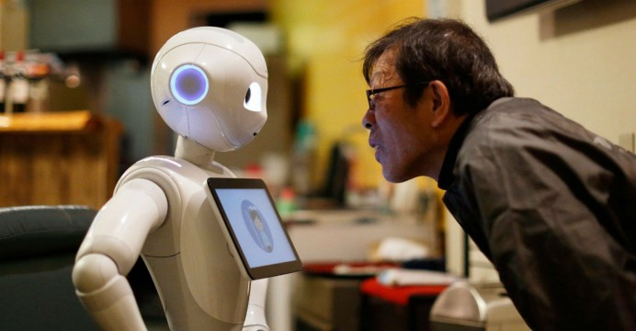
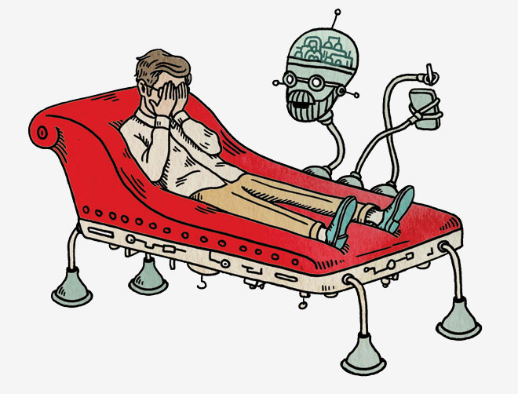
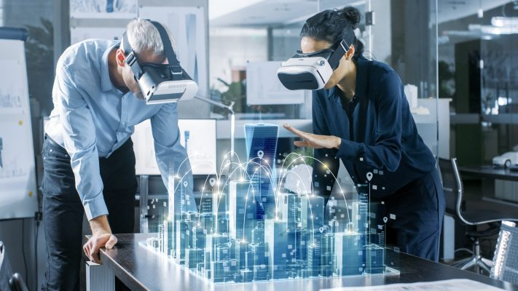
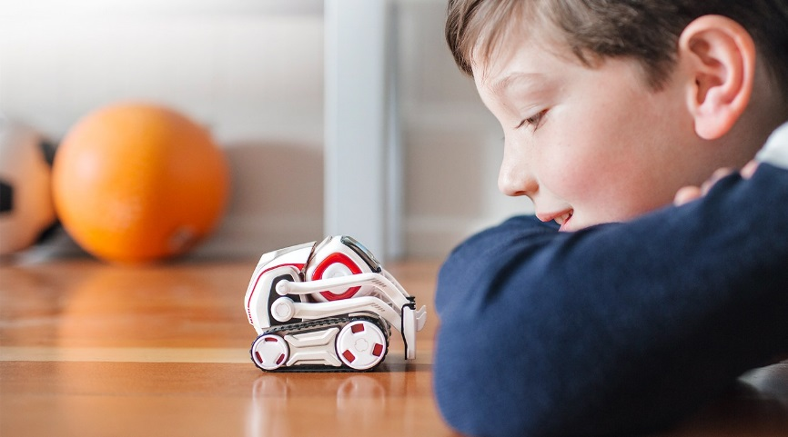
Jobs in the Future…

Slide 31
https://www.itc-conference.com/
ICEME2018
Manila, Philippines

Slide 32
For Further Reading:
The ITC International Handbook of Testing and Assessment
edited by Frederick T.L.Leong, Dave Bertram,
Fanny Cheung, Kurt F.Geisinger,Dragos Iliesco
Oxford University Press, 2016
Standards for Educational and Psychological Testing (AERA,APA & NCME, 2014)
@ www.aera.net/standards14
ICEME2018
Manila, Philippines

Slide 33
Internet Sources about Tests
American Educational Research Association (AERA) http://www.aera.net
American Psychological Association (APA) http://www.apa.org
Association of Test Publishers (ATP) http://testpublishers.org
Buros Institute of Mental Measurements (BI) http://unl.edu/buros
Educational Resources Information Center (ERIC) http://eric.ed.gov
Educational Testing Service (ETS) http://ets.org/testcoll/index.html
International Test Commission (ITC) http://intestcom.org
National Council on Measurement in Education (NCME) http://www.ncme.org
ICEME2018
Manila, Philippines

Slide 34
ITC Book Series…
Adapting tests in linguistic and cultural contexts by Dragos Iliesco
International applications of web-based testing: challenges and opportunities by John Scott, Dave Bertram and Douglas Reynolds
Measuring opportunity: Insights from international large scale assessment by William Schmidt, et al.
Assessing measurement invariance by applied researchers by David Wells
Higher Education admission practices: An International perspective by Maria Elena Oliveri and Cathy Wendler
Call for writing books on: - history of testing international
- personality testing
- test security challenges
ICEME2018
Manila, Philippines

Slide 35
Acknowledgements
Eric Bryan Anthony Amaladas, Director, CAREERsense@HELP
Brenda Shalini A/P Kesavamani, Deputy Manager, CAREERsense@HELP
Noor Syahirah Badrol Alam,
Student Intern-Research Assistant
ICEME2018
Manila, Philippines

Slide 36
For queries, you may email: marife.mamauag@help.edu.my
ICEME2018
Manila, Philippines

