Slide 1
Challenges and Opportunities in Testing and Assessment in the Philippines
Marife M.Mamauag, PhD (cand.)
Chair, Test Development Division, PEMEA, Inc.
NCEME 2015

Slide 2
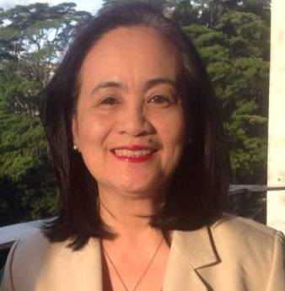
Brief Bio-Profile
Assessment Consultant-Senior Lecturer
HELP University, Kuala Lumpur, Malaysia
2014 to date
Director (formerly)
Center for Learning & Performance Assessment
De La Salle-College of Saint Benilde, 2005-2013
Founding Member, PEMEA, Inc. ( Formerly Treasurer, 2008-2010 & Secretary, 2011-2013)
Research Consultant
Asian Psychological Services & Assessment, Inc.
Research Fellow, SEAMEO-INNOTECH
MS in Educational Measurement & Evaluation
CEM- FAPE-IEMES scholar, DLSU
PhD in Educational Psychology (dissertation writing) De La Salle University, Manila
Developed over 20 standardized educational and psychological tests/scales

Slide 3
Challenges
Few are engaged in the Test Development Industry
(CEM, APSA, private practitioners)
Few schools offering Psychometrics as a specialization
PEMEA, Inc. (infantile stage)
Need to build future leaders and experts in assessment
Need to create standards in educational and psychological testing and assessment

Slide 4
Opportunities
Emerging methodologies and technologies in Psychometrics
Many topologies on 21st century teaching and learning; New global trends; Digital Age
UNESCO’s Learning Metrics Task Force
Revolutionizing the use of IRT techniques
New K to 12 basic education curriculum
Forging standards-based assessment
Advocacy for college and career readiness
PEMEA as an affiliate member in ITC

Slide 5
Action Plan
Creation of the Experts Team to craft the assessment framework, and standards in educational and psychological testing Oct 2015
Needs Assessment Survey (schools and industry) November 2015 to February 2016
Inventory of Best Practices Jan to Feb 2016
Benchmarking/Networking (APA, AERA, NCME, ITC) Jan to Feb 2016
Strategic Planning Workshop: Strategic Directions for the next Five Years April 2016
Preparation for the ICEME 2016 May to August 2016

Slide 6
Call for Division Members/Experts
Expanding membership to the specialty division
Accepting nominations for the Experts Team
Email:
marife.mamauag@gmail.com

