Slide 1
The Education University of Hong Kong (EdUHK)

Slide 2
About EdUHK

Slide 3
Higher Education in Hong Kong
8 “Government” Universities funded by University Grants Committee (UGC)
City University of Hong Kong (CityU)
Hong Kong Baptist University (HKBU)
The Hong Kong University of Science and Technology (HKUST)
Lingnan University (LU)
The Chinese University of Hong Kong (CUHK)
The Education University of Hong Kong (EdUHK)
The Hong Kong Polytechnic University (PolyU)
The University of Hong Kong (HKU)

Slide 4
Ranking
QS (Quacquarelli Symonds)
World University Ranking 2018
2nd in Asia and 9th in the world in Education
5

Slide 5
Organizational Structure
Faculty of Liberal Arts and Social Sciences (FLASS)
Department of Asian and Policy Studies (APS)
Department of Cultural and Creative Arts (CCA)
Department of Health and Physical Education (HPE)
Department of Mathematics and Information Technology (MIT)
Department of Science and Environmental Studies (SES)
Department of Social Sciences (SSC)
Faculty of Education and Human Development (FEHD)
Department of Curriculum and Instruction (C&I)
Department of Early Childhood Education (ECE)
Department of Education Policy and Leadership (EPL)
Department of International Education and Lifelong Learning (IELL)
Department of Special Education and Counselling (SEC)
Department of Psychology (PS)
Faculty of Humanities (FHM)
Department of Chinese Language Studies (CHL)
Department of English Language Education (ELE)
Department of Linguistics and Modern Language Studies (LML)
Department of Literature and Cultural Studies (LCS)
Graduate School

Slide 6
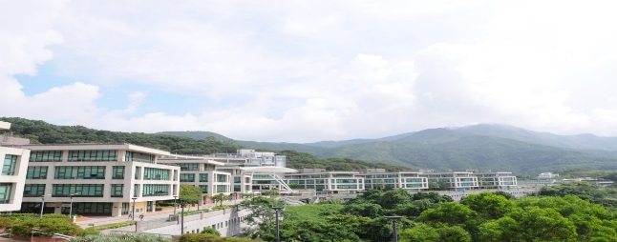
University-level Research Centres
Academy of Hong Kong Studies (AHKS)
Assessment Research Centre (ARC)
Centre for Governance and Citizenship (CGC)
The Joseph Lau Luen Hung Charitable Trust Asia Pacific Centre for Leadership and Change (APCLC)

Slide 7
Hong Kong PhD Fellowship Scheme (HKPFS)

Slide 8
Hong Kong PhD Fellowship Scheme (HKPFS)
Eligibility
New full-time PhD students in the eight universities in HK including the Education University of Hong Kong, irrespective of their country of origin, prior work experience, and ethnic background.
Applicants should demonstrate outstanding qualities of academic performance, research ability / potential, communication and interpersonal skills, and leadership abilities.
Application Period (i.e. 1 Sept – 1 Dec 2018)
Monthly Stipend and other travel allowance:
Monthly Stipend (2019/20) | Conference and research-related travel allowance
HK$25,100 (approximately US$3,220) | HK$12,600 per year (approximately US$1,620) up to 3 years

Slide 9
Application Steps
Step 1:
Complete the initial application in HKPFS website
Step 2:
Complete online application in EdUHK website
(with HKPFS ref. no.)
Step 3:
Submit the following documents to EdUHK:
Research Plan & Vision Statement
2 Referee Reports

Slide 10
PhD and MPhil Programmes at EdUHK

Slide 11
Student Support
Publication Awards Scheme
cash award for published journal articles
Certificate Course “Introduction to Teaching in Higher Education”
Develop RPg / EdD students’ professionalism related to learning and teaching
Student Tutor and Peer Support System
Research Software
SPSS Statistics 21 Network version and NVivo11

Slide 12
Student Support
Academic Writing Support
Free Individual writing consultation, workshops etc.
Statistical Consultation Services
International Outreach Study Programme
Study trips to overseas universities to interact with local students and scholars
Cultural visits
Annual International Postgraduate Research Roundtable and Forum cum Summer School
An event that gathers international postgraduate students and scholars

Slide 13
Dual PhD Programmes
Collaboration with Macquarie University, Australia and University of Lorraine, France
Upon successful completion of all requirements
Two testamurs (A PhD degree by EdUHK and a PhD degree by partner universities) will be awarded
Establish an international network for future career prospects

